Slide 1
A Christian Mental Health Service – experiences from Switzerland
Dr. med. Samuel Pfeifer, Switzerland
CMS Psych Day
London 2010

Slide 2
Switzerland - more than tourism

Slide 3
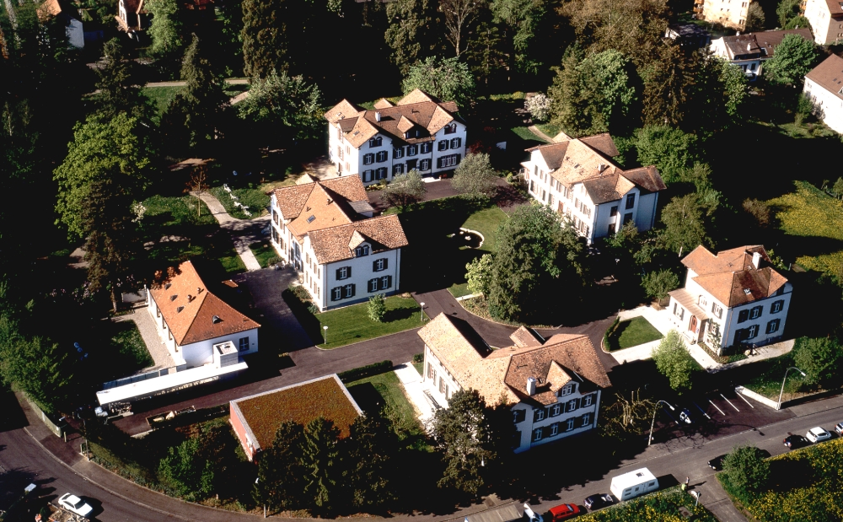

Slide 4
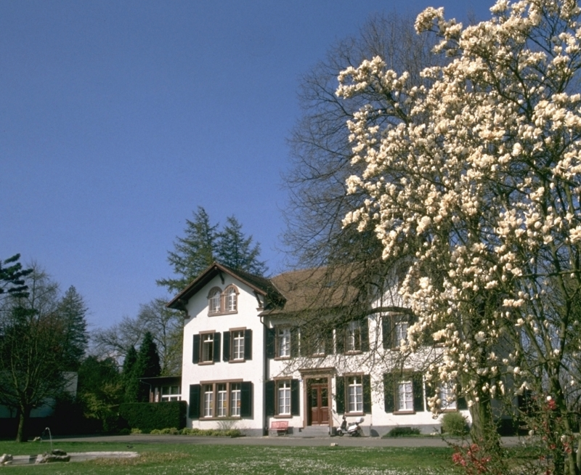

Slide 5
History since 1900

Slide 6
Education, Supervision, Fellowship

Slide 7
Three pillars
Compassionate
Professional
Christian

Slide 8
Therapeutic Concept
Social
Therapy
Disorder-
specific
Therapy
Rehab
Work
Milieu-Therapy

Slide 9
Therapeutic Milieu
... A temporary community of persons who have been brought together by the individual course of their lives and the course of their illness – a community of suffering, but also a community of coping.
Organizing and shaping the therapeutic milieu is one of the most important tasks of the treatment team. Basic principles of the ward structure are adapted to the individual needs of a patient.
Precursors of this model: “Moral treatment”

Slide 10
Week Schedule
Montag |  | Dienstag |  | Mittwoch |  | Donnerstag | Freitag
08.10 – 08.30 Andacht |  | 08.10 – 08.30 Andacht |  | 08.10 – 08.30 Andacht |  | 08.10 – 08.30 Andacht | 08.10 – 08.30 Andacht
08.30 – 09.00 Morgentreff |  | 08.30 – 09.00 Morgentreff |  | 08.30 – 09.00 Morgentreff |  | 08.30 – 09.00 Morgentreff | 08.30 – 09.00 Morgentreff
 |  | 08.35 – 09.00 Laufgruppe |  |  |  | 08.35 – 09.00 Laufgruppe
09.30 – 11.00 Kreativ-Atelier Gruppe III | 09.30 – 10.05 Gymnastik Gruppe I | 09.30 – 10.30 Kreativ-Atelier Gruppe II | 09.30 – 10.05 Gymnastik Gruppe III | 09.30 – 10.30 Kreativ-Atelier Gruppe II | 09.30 – 10.05 Gymnastik Gruppe I | 09.30 – 10.05 Gymnastik Gruppe III | 09.30 – 10.30 Kreativ-Atelier Gruppe II | 09.30 – 10.05 Gymnastik Gruppe I
 | 10.40 – 11.15 Gymnastik Gruppe II | 10.40 – 11.15 Gymnastik Gruppe VI | 10.30 – 11.30 Kreativ-Atelier Gruppe III | 10.40 – 11.15 Gymnastik Gruppe II | 10.30 – 11.30 Kreativ-Atelier Gruppe I | 10.40 – 11.15 Gymnastik Gruppe VI | 10.40 – 11.15 Gymnastik Gruppe II | 10.30 – 11.30 Kreaitv-Atelier GruppeI
 |  | 10.30 – 11.30 Gesprächsgruppe | 10.30 – 12.00 Gruppe „ A“ | 10.30 – 11.30 Gruppentherapie |  | 10.30 – 11.30 Gedächtnistraining
13.00 – 14.15 Kreativ-Atelier Gruppe II |  | 14.45 – 16.00 Malgruppe |  | 13.00 – 14.30 Kreativ-Atelier Gruppe III |  | ab 14.30 Gemeinsamer Nachmittag | 14.30 – 15.30 Wochenausklang
14.30 – 16.00 Kreativ-Atelier Gruppe I |  | 16.00 – 17.00 Sing- und Spielgruppe im Ottilienhaus |  | 14.15 – 15.15 Atem und Bewegung
 |  |  |  | 16.00 – 17.30 Gruppe Essstörungen

Slide 11
Milieu-Therapy

Slide 12
Milieu-Therapy

Slide 13
Switzerland – Facts and Figures
7.3 Million inhabitants (1.4 non-Swiss)
Life expectancy: f 82,6 y; m 76,7 y
40.000 squ. Km, half of it: alps
Four languages (German, French, Italian, Rumantsch)
CH: Confoederatio Helvetica
26 cantons
Capital Bern
Notes:
Es gibt deutschsprachige, französischsprachige und einen italienischsprachigen Kanton, und es gibt Kantone, in denen deutsch und französisch und einen Kanton (der Kanton Graubünden), in dem deutsch, italienisch und rätoromanisch gesprochen wird. Es gibt Kantone, die praktisch nur aus einer Stadt bestehen, zum Beispiel den Kanton Genf, und es gibt Kantone, die fast nur aus Bergen und Tälern bestehen, wie der Kanton Uri. Im kleinen Halbkanton Basel-Stadt mit seinen 37 km2 leben mehr Menschen (188'500) als im Kanton Graubünden (7105 km2), in dem sich die 186'000 Einwohnerinnen und Einwohner auf 150 Täler verteilen. Der Kanton Zürich hat über eine Million Einwohnerinnen und Einwohner, andere Kantone füllen mit ihrer Bevölkerung nur ein kleines Fussballstadion, wie zum Beispiel der Kanton Appenzell Innerrhoden mit 14'900 Einwohnenden. Es gibt ältere und jüngere Kantone, der jüngste ist der Kanton Jura, der sich 1979 vom Kanton Bern trennen konnte, nachdem diese Trennung 1978 von einer Mehrheit der Schweizer Stimmenden gutgeheissen worden war. Drei Kantone bestehen aus je zwei Halbkantonen

Slide 14
Confederate Psychiatry is regional
Every canton has at least one state psychiatric hospital
Private psychiatric hospitals (since ~ 1880)
Social Psychiatry (since ~ 1970)
Therapeutic networks
Trend: Reduction of inpatient services, more outpatient and partial hospitalization treatment.

Slide 15
Map of Switzerland
Clinic Sonnenhalde
Region

Slide 16
Cooperation with National Health System
State funding for regional patients with basic insurance package (28 of 63 beds)
Basic package plus «all of Switzerland» (25 beds)
Patients with private insurance (10 beds)

Slide 17
Diagnostic Groups State Clinic
Figures 2002 Psychiatric Clinic Canton Aargau

Slide 18
Diagnostic Groups Clinic Sonnenhalde
Organic Disorders 6
Subst. Abuse Dis. 36
Schizophrenia 56
Affective Disorders 239
Anxiety Disorders 32
Various D. 33
59 % Depressions

Slide 19
Comparison
F0 = Organic Disorders
F1 = Substance Dependency
F2 = Schizophrenia
F3 = Affective Disorders
F4 = Anxiety Disorders
F5 = Eating Disorders
F6 = Personality Disorders
State Clinic
Open Clinic

Slide 20
The therapeutic network
State Clinics
Clinic
Policlinics
Day Care Clinic
GP
Psychiatrist
Outpatient Dept.
Counselors
Inpatient Services: 63 beds, 400 intakes per year
Day Care Clinic: 20 Patients
Outpatient Dept: >11‘000 Consultations p.y., 1400 patients
Sheltered Homes

Slide 21
Bild Ärzte 2008!!
Our Team 2008

Slide 22
Facts and Figures
Age
Region
Length of stay

Slide 23
Three pillars
Compassionate
Professional
Christian

Slide 24
Compassion – the attitude of Jesus
Matthew 9,36: He was moved
When he saw the crowds, he had compassion on them, because they were harassed and helpless, like sheep without a shepherd. (NIV)
35-37 - Then Jesus made a circuit of all the towns and villages. He taught in their meeting places, reported kingdom news, and healed their diseased bodies, healed their bruised and hurt lives. When he looked out over the crowds, his heart broke. So confused and aimless they were, like sheep with no shepherd.“ (The Message)

Slide 26
Three pillars
Compassionate
Professional
Christian

Slide 27
Professional Issues
Medical interest, knowledge and continuing education.
Having a model of disease and healing.
Having a model of supportive treatment in chronic illness.
Integrating Psychiatry and Theology on an academic and professional level.
Boundaries: The problem of professional sexual misconduct; acknowledging your own limitations (“He grants peace to your borders” – Psalm 147,14).

Slide 28
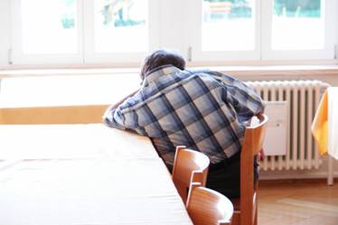
What are the causes of depression?
We have to give basic answers to the questions of our patients.
PSYCHO-EDUCATION

Slide 29
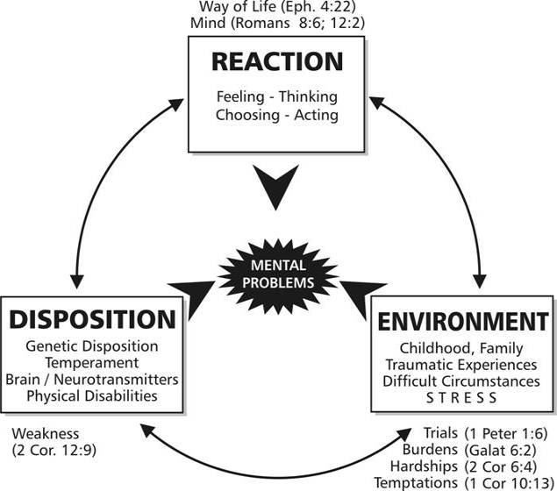
The Bio-Psycho-Social Model

Slide 30
Publications
Notes:
30

Slide 31
Psychotherapeutic methods
Cognitive-behavioral Therapy
Systemic Therapy
Psychodynamic Therapy
Client-centered Therapy (Rogers)
Trauma Therapy
Mindfulness (?)
Body-oriented approaches
Supportive Therapy

Slide 32
Three pillars
Compassionate
Professional
Christian

Slide 33
Distinct Christian Elements
Doctors and nurses try to make their faith fruitful in their daily contact with the patients and to create a personal ward atmosphere, fostering a general attitude of friendliness, trust and feeling at home, which is so important for successful psychotherapy.
Spiritual help in the form of daily devotions and personal application of biblical help are offered to those who wish it. However, we want to show love also to patients who are not yet open for the gospel in a personal way. They should see the love of God through our lives.

Slide 34
Christian aspects, contd.
A pastoral counselor is an indispensable member of the therapeutic teams. His task is not to do counseling instead of doctors and nurses but rather to advise them how to do it and to support them in difficult situations.
Psychotherapy is supported through prayer.
Problems in human relations among team members are approached on the common ground of the gospel.

Slide 35
Christian perspective
Serving Christian patients – opening up perspectives
“Let us read the Bible thinking constantly of our daily lives, and let us live our lives thinking constantly of the Bible.”
Theology-Professor Emil Brunner

Slide 36
Challenges
Keeping the vision: Medical director and director of nursing must have a clear view of the goal. Prayer and inspiration through contact with other Christians in the field.
Finding the right doctors and nurses who support the concept of a Christian Psychiatric Hospital, and who fill it with their personal zeal.
The human factor: Christians are human too, interpersonal problems need constant attention and - if possible Biblical solution. Giving freedom in personal matters, not demanding a distinct religious style.
Wisdom in integrating new techniques and developments in the area of psychiatry and psychotherapy. Applying a "biblical grid “.
Wise financial policy.

Slide 37
Areas of tension
I D E A L S
Inner Experience
I want to do what is right and good, pleasing to God.
*** other ideals ??
Needs, desires
Drives, Impulses
Emotions
(Sub)cultural rules und limitations
R E A L I T Y
General life situation
Social network
Physical/emotional constitution
External Framework
Notes:
Even if there are no external limitations, they are created by negative experiences and transmitted to the next generation or the group of followers. Imagine a boy sleeping with a girl (in love and without moral restriction) and then disappointing the girl. She starts crying, clings to him, shouts at him – negative experience. He may learn from this experience and create new moral standards.
SENSITIVE PERSONS perceive the consequences of their acts and behaviour more sensitively and thus create more subcultural (sensitive) rules and limitations, moral guideline, moral scruples.
IDEALS
An important ideal (without religion) is solidarity
Love for a person

Slide 38
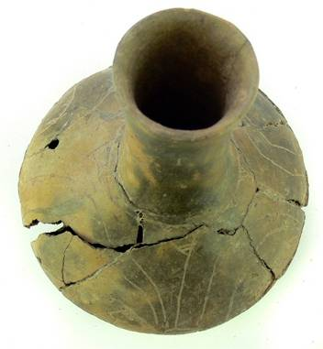
Jars of clay
For God, who said, „Let light shine out of darkness“, made his light shine in our hearts to give us the light of the knowledge of the glory of God in the face of Christ. But we have this treasure in jars of clay to show that this all-surpassing power is from God and not from us.
2 Corinthians 4:6-7

Slide 39
Download
www.seminare-ps.net/en
www.sonnenhalde.ch

