Slide 1
INTERNET ADDICTION understanding – counseling – coping
Prof. Dr. med. Samuel Pfeifer

Slide 2
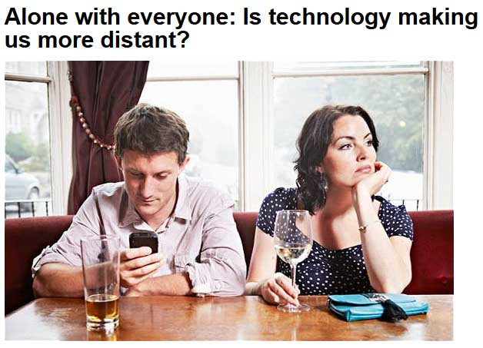
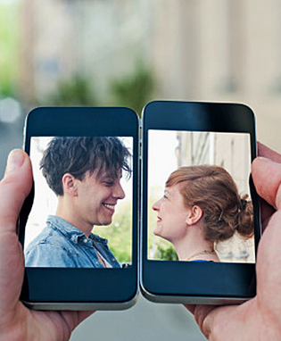
Smartphones have changed relationships

Slide 3
Internet Devices are addictive
Adam Alter (2017). IRRESISTIBLE. The Rise of addictive technology and the business of keeping us hooked. Penguin Books.
Our devices – they are the masters, we are not. They are built to addict us, to madden us, distract us, arouse us and deceive us. We primp and perform for them as for a lover; we surrender our privacy to their demands; we wait on tenterhooks for every “like.” The smartphone is in the saddle, and it rides mankind.

Slide 4
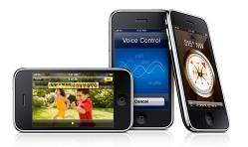
Five areas with a potential for addiction
Pornography
Chat
Online-Games
Internet-Casino / Gambling
Mobile Data

Slide 5
Sex-Chat – ruin of a career
Democratic Congressman of New York had to resign from Congress in June 2011 after the first of several sexting scandals became public.

Slide 6
Case vignette 1 – Psychotherapy - Cyberporn
The 13 year old daughter wants to access the internet using her father‘s laptop computer. Suddenly, she is confronted with a hidden folder containing thousands of pornographic images. Within her, a world is breaking apart. Her father whom she has admired, the good teacher, the active Christian – how does it fit with such material? She suffers a nervous breakdown, cries all day long, stops eating, skips school. She smashes the laptop by throwing it out of the window. The whole family is in a dramatic crisis. It is in this situation that they come for family therapy.

Slide 7
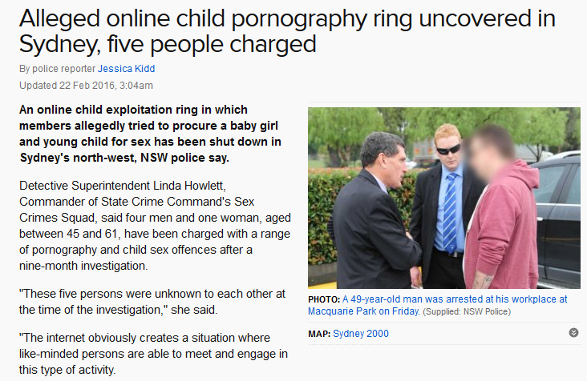
Huge business with many victims
Sex Addicts have to be fed a constant stream of new images.
Police and Law agencies are very limited in the war against trafficking and exploitation

Slide 8
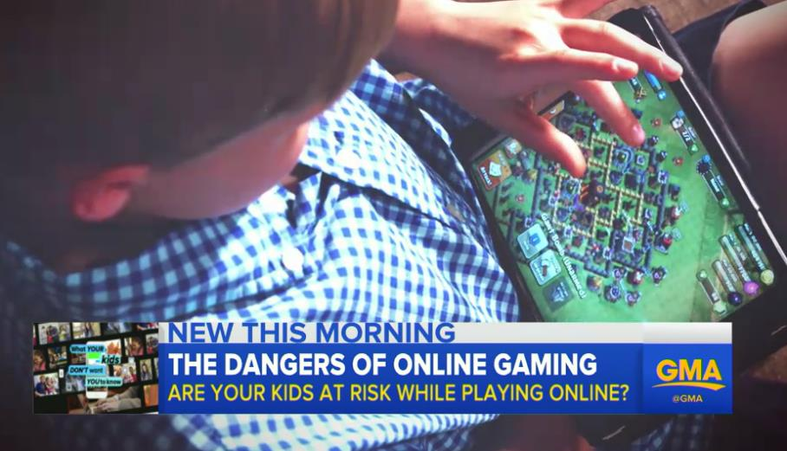
Online Games may be dangerous
Long hours of gaming
Other responsibilities are neglected
Real life contacts are neglected
97 Prozent of all pedosexual perpetrators are using the internet to establish contact with children
WATCH a video on sexual grooming while online gaming

Slide 9
Social media / Chat
31 % of young people are chatting excessively.
45 % have already been mobbed in social media
Only 7 % of parents are aware of their childrens activities in the net

Slide 10
Chat influences Self Worth
She told me that in the chat, she can be just herself. Nobody comments on her overweight, nobody thinks she is not pretty …
In the Chat she is desirable, everyone thinks she has a perfect body and that she is the most beautiful girl in the world.
But she also thinks, if others knew, they would not want her anymore…
(Interview with a young man regarding his girl friend)
Quelle: www.onlinesucht.de

Slide 11
Case Example
A 32-year old woman asks for therapy with intensive fears. Chatting in the Internet has often helped her deal with her loneliness.
A few months ago she met a man in the chat room - first only virtually – they were flirting, feeling attracted to each other. They make a date. The atmosphere is „loaded“, they finally have sex together.
Soon after, the man is not interested in her any more, they lose contact.
Only now, she starts to realize that she has been used. She is worrying about a possible HIV-infection. But she also wonders: Where has my internet addiction led me? What is happening with me?

Slide 12
Tragedies

Slide 13
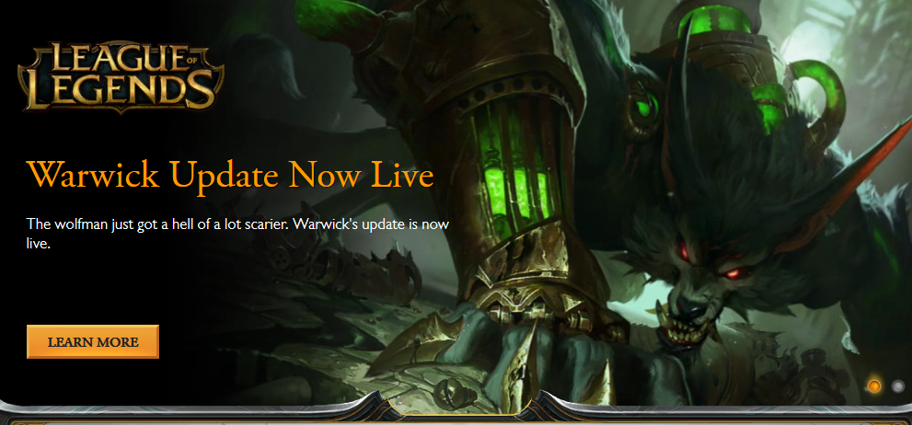
Online Games

Slide 14
Millions of Gamers worldwide
Every second 10-year-old has games that are only released from 16 or even 18.
Professional gamblers earn their livelihood through prize money ("cyber-hermits") in game marathons lasting for log hours or days
Cyber Games are "normal everyday pleasure" for many young people - particularly popular: ONLINE-GAMES live
„Egoshooter“ simulating war scenes
Victims are only pixels EXAMPLES
Doom 3
Counterstrike
World of Warcraft (8 Millionen Spieler)
u.v.a.m.

Slide 15
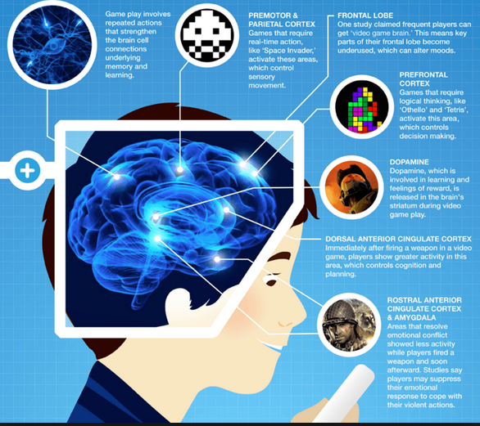
Mixed effects
Games May Teach Skills—or Desensitize Us to Violence
Some research suggests that kids who regularly play video games are at a slightly increased risk for developing attention problems at school.
And it’s clear that some kids are out of control--playing video games so frequently that the games begin to dominate their lives.
But it's also likely that playing action video games can boost visual spatial skills and perhaps even help dyslexic children improve their reading ability.

Slide 16
Warning signs
Do I play for hours without noticing how time passes?
Do I neglect important duties (school, tasks) and friendships because of the game?
Do I play to reduce my aggression?
Does a computer game excite my feelings?
Does it cause physical reactions? (Fear sweat, trembling, punching at the screen) - indication of strong resonance.
other warning signs (PIG)

Slide 17
Lost in virtual space
“The tipping point is reached when the people feel more comfortable in their virtual worlds than in real life.”
The brain adapts to the tasks and rewards placed in computer games, it changes demonstrably.
Prof. Gerald Hüther, Neurobiologe
(Bergmann / Hüther: Computersüchtig. Kinder im Sog der modernen Medien, Walther Verlag)

Slide 18
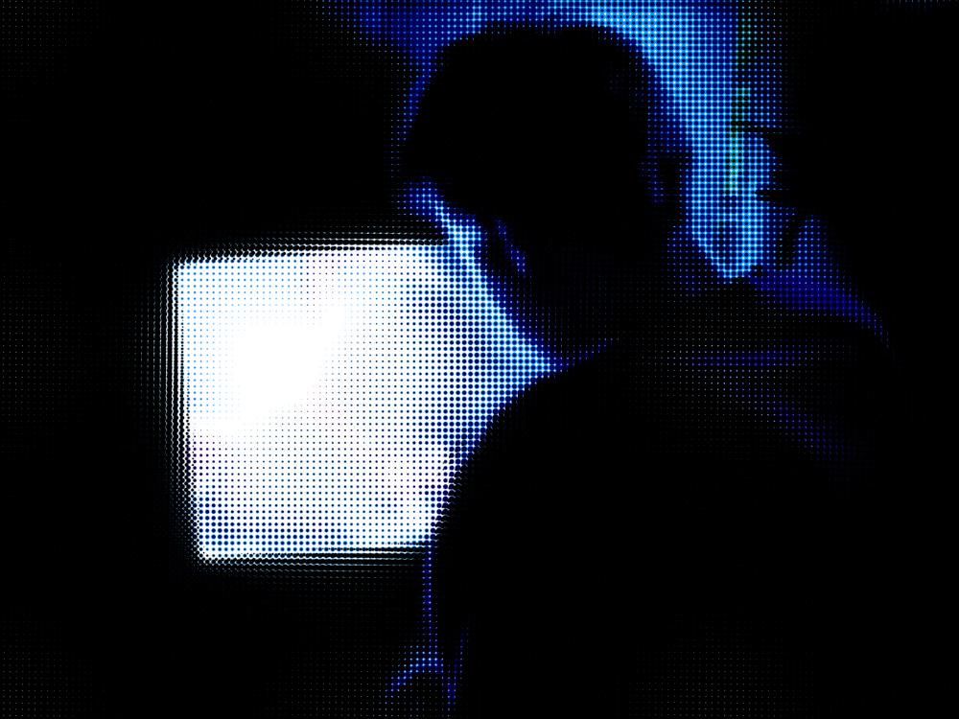
Internet Pornography

Slide 19
Example 2
The pastor of a large church is, together with his wife, heavily involved in church activities. They provide leadership, they counsel others, they organize events – but there is no time for themselves as a couple.
One evening, pastor D. is checking his E-mail. A friendly text, a link, a mouse-click, and he finds himself in a pornographic web-site. He is both disgusted and fascinated.
Soon he is sliding into the habit of logging into the net to relax. Two months later he is confronted by the IT-person in his church with a printout of his activities. In this situation, he starts with therapy regarding his dependency.
Notes:
Beispiel nach Earle/Laaser, S. 67-68

Slide 20
Some Statistics
Affecting Adults
20% of men admit accessing pornography at work
13% of women admit accessing pornography at work
10% of adults admit having internet sexual addiction.
Business Productivity
70 percent of all internet porn traffic occurs during the 9-to-5 workday.
Nearly one out of three companies has terminated an employee for inappropriate web use.
30 to 40 percent of employee internet activity is non business-related, costing millions of dollars in productivity. Not all the activity is porn related. Frequent News Zapping – checking private mails and Social Media

Slide 21
DIMENSIONS
Content
Frequency
Context / Effects
Pedophilia
Violence
Hardcore
Soft pornography
Sporadic
Frequent
Partnership
Work
Legal Consequences
Medical Consequences
Personal Discontent / Feelings of Guilt
Content
Pädophilia
Violence Excrements Animals
Frequency 5 – 35 hrs / week
Hardcore
Soft, but frequent
Soft pornography
sporadic
Effects

Slide 22
DIMENSIONS
Undiscovered – risk behavior
Content
Discovery – severe problems
Sporadic – no legal implications
Pädophilia
criminal
Social / legal Consent
Violence Excrements Animals
Frequency 35 hrs / week
Hardcore
Value discussion / partnership
Soft, but frequent
Soft pornography
sporadic
Effects
(may cumulate)
Pers. Discontent Feelings of Guilt
Legal Consequences
Partnership
Med. Consequ.
WORK

Slide 23
Pornographic internet content
Everything is possible
„soft pornography“
„hard pornography“
„sexually explicit in the extreme, and devoid of any other apparent content or purpose“ – including violence, sado-maso, electroshocks, urine, feces, very fat women, pregnant women etc., „gang-bang“, animals; even „snuff-videos“ – killing victims in front of the camera.
pedophile content (often with sadistic torture)
Chat with explicit sex talk – often leading to real-life encounters.
Live-Video
Mobile telephones: growing industry of short films, pictures, explicit sounds.

Slide 24
Diagnostic Criteria

Slide 25
Internet Addiction Disorder (IAD) - Diagnostic Criteria
A maladaptive pattern of Internet use, leading to clinically significant
impairment or distress as manifested by three (or more) of the following,
occurring at any time in the same 12-month period:
(I) tolerance, as defined by either of the following:
(A) A need for markedly increased amounts of time on Internet to achieve satisfaction
(B) markedly diminished effect with continued use of the same amount of time on Internet.
Author: Ivan Goldberg, M.D.

Slide 26
Criteria – IAD II
(II) withdrawal, as manifested by either of the following:
(A) the characteristic withdrawal syndrome
(1) Cessation of (or reduction) in Internet use that has been heavy and prolonged.
(2) Two (or more) of the following, developing within several days to a month after Criterion 1: (a) psychomotor agitation - (b) anxiety - (c) obsessive thinking about what is happening on Internet - (d) fantasies or dreams about Internet - (e) voluntary or involuntary typing movements of the fingers.
(3) The symptoms in Criterion B cause distress or impairment in social, occupational or other important other area of functioning
(B) Use of Internet or a similar on-line service is engaged in to relieve or avoid withdrawal symptoms
(III) Internet is often accessed more often or for longer periods of time than was intended.

Slide 27
(IV) There is a persistent desire or unsuccessful efforts to cut down or control Internet use.
(V) A great deal of time is spent in activities related to Internet use
(e.g. organizing files of downloaded materials; researching Internet vendors, trying new browsers.)
(VI) Important social, occupational, or recreational activities are given up or reduced because of Internet use.

Slide 28
Destructive consequences
(VII) Internet use is continued despite knowledge of having a persistent or recurrent physical, social, occupational, or psychological problem that is likely to been caused or exacerbated by Internet use
sleep deprivation, marital difficulties, lateness for early morning appointments, neglect of occupational duties, or feelings of abandonment in significant others.
Isolation
Job loss

Slide 29
Cybersex – „just a click away“
easily accessible
affordable
anonymous
Cyber-Psychologist John Suler describes „Toxic Disinhibition“
„You don‘t know me.“
„You can‘t see me.“ Being invisible gives people the courage to write and think things they would never do in a real-life situation.
Notes:
Beispiel nach Earle/Laaser, S. 67-68

Slide 30
Disease or behavioral problem?
Diagnostic Category following ICD-10 / DSM-IV unclear
Disorders of sexual preference (Paraphilia)?
OCD?
Disorders of Impulse control?
Non-substance Addiction?
Internet addiction disorder – IAD (Ivan Goldberg 1995)
Pathological Internet Use − PIU (Kimberly S. Young)
Notes:
Hollander 2004
Bis heute sehr wenige Daten zum Problem
Am ehesten passt das Verhalten zu einer sucht-artigen Störung
Die Gesamtkonstellation muss als neue Form der Sexualstörungen betrachtet werden

Slide 31
Value shift
Online Addicts realize that they give up values which have been important to them:
Respect of the other person.
Repulsion of violence and coercion.
Christian values of integrity, purity and self discipline.
Reinterpretation and Minimizing:
It is only pictures! It‘s only a game!
I have so much stress! That helps me to relax! I have deserved this.
Others do it, why not me?

Slide 32
Three stages
Stage of Endangerment:
Fulfills 1 – 3 criteria over the last six months.
Critical Stage:
Fulfills at least four criteria over the last six months.
Chronic Stage:
Fulfills more that four criteria over more than six months.

Slide 33
Complications - Comorbidity
Alcoholism: Alcohol is being used to get calmer but also to enhance the sexual excitement.
Substance abuse (from Cocain to Viagra)
Depressive Episodes: caused by negative psychosocial consequences of the cyber-addiction or the break-up of relationships.
Suicidal thoughts: out of despair and hopelessness.
Obsessive-Compulsive Behavior: Online addicts develop complex rituals to conceal their dependency and to make sure their family, colleagues or company cannot access their “hidden area”.
Paranoid Thinking: Fear of being discovered and being ashamed lets them associate even marginal observations with personal threats. (Examples: If a police car passes: “I hope they do not come to confiscate my computer!” – If the boss asks for a meeting: “Does he want to confront me with my Internet activities during last week?”)

Slide 34
Differences between men and women
MEN
„Kick“ through visual material
Sexual excitement with masturbation.
collecting mania.
tendency towards violent and abasing content.
WOMEN:
„Kick“ through communication (Chat).
Romantic stories and images
Sexual excitement is secondary.
Notes:
Beispiel Kimberly Young:Diese Frau führte demnach ein zufriedenes und ausgeglichenes Leben, ohne jegliche Anzeichen, suchtgefährdet zu sein. Als sie einen Heimcomputer bekam, hat sie in den ersten drei Monaten in zunehmenden Ausmaß Chatrooms frequentiert. Es sei zu einer Art Toleranzsteigerung gekommen, die Hausfrau habe Online-Zeiten von bis zu sechzig Stunden pro Woche erreicht. Sie habe sich bald auf einen bevorzugten Chat konzentriert, wo sie sich "etablierte" und eine Art Gemeinschaftsgefühl entwickelte. Sehr bald konnte sie - entgegen besserer Absicht - die Zeit der verbrachten Sessions nicht mehr kontrollieren. Diese hätten manchmal bis zu 14 Stunden angedauert. Wenn sie nicht online sein konnte, habe sie depressive Verstimmungen, Angstzustände und Irritabilität entwickelt. In der Folge begann sie, Verabredungen nicht mehr einzuhalten und ihre Freunde zu vernachlässigen, ebenso wie ihr Familienleben, sowie früher geschätzte soziale Aktivitäten nicht mehr auszuüben.

Slide 35
USER-PROFILE of Porn Dependency *
Adapted
Recreational use
Non-adaptive
Recreational use
Dicovery Group
Lifelong sexual dependency
Endangered Group
nach Carnes 2001
* Deskriptive moral term
Notes:
Die folgende Einteilung der Muster des Internet-Sex-Gebrauchs ist nicht wertend, sondern rein beschreibend (vgl. auch S. 2).
Gruppe A: Nichtsüchtige Nutzer
a) Angepasster Freizeitgebrauch: Es gibt nicht wenige Menschen, die erotisches Material lesen oder ansehen, ohne dadurch in eine pathologische Abhängigkeit zu verfallen oder eine Verschiebung ihrer sexuellen Präferenzen oder der Achtung vor dem anderen Geschlecht zu erleben. Diese werden als «angepasste Freizeitnutzer» beschrieben.
b) Unangepasster Freizeitgebrauch: Obwohl diese Gruppe nicht süchtig ist, geht sie mit sexuellen Inhalten des Internets in anstößiger Weise um: Dies sind z.B. die schmierigen Typen, die pornografische Bilder an die Kollegin schicken, um sie in Verlegenheit zu bringen. Im Gegensatz zu Online-Süchtigen versuchen sie nicht, ihren Spaß an derartigen Bildern zu verstecken.
Gruppe B: Problematische Nutzer
c) Entdeckergruppe: Diese Menschen hatten vor der Entdeckung im Internet keine Probleme mit süchtiger Sexualität. Sie gehen vielleicht zuerst fast mit spielerischer Neugier in einen Chatroom oder eine Porno-Adresse. Doch dann werden sie hinein gezogen und verbringen immer mehr Zeit im Netz, riskieren immer mehr und werden abhängig.
d) Prädisponierte Gruppe: Diese Menschen hatten zwar schon früher unangepasste sexuelle Fantasien, etwa zu einer Prostituierten zu gehen, oder ein Kind unsittlich zu berühren, doch sie lebten diese Impulse nie aus, weil sie sich schämten. Nun entdecken sie im Internet die Erfüllung ihrer Wünsche, ohne erkannt werden zu können. Zuerst verweilen sie nur einige Stunden pro Woche im Netz, doch dann wird es immer mehr. Dazu kommen auch zunehmend extremere Variationen der Sexualität, um noch einen «Kick» zu bekommen. Sie werden süchtig.
e) Lebenslanges sexuelles Suchtverhalten: Diese Menschen zeigen schon seit der Jugend problematisches sexuelles Verhalten: häufige Masturbation, Gebrauch von pornografischem Material, Voyeurismus, Exhibitionismus oder pädophile Handlungen (all das, was in der Diagnostik als «Paraphilien» bezeichnet wird). Für sie bietet das Internet die Möglichkeit, ihre bestehendes sexuelles Muster in einer neuen Form auszuleben.
Dabei kann man wiederum drei Untergruppen unterscheiden:
1. Diejenigen, die das Internet als zusätzliche Möglichkeit nutzen, um das gewohnte Verhalten auszuleben.
2. Diejenigen, die im Internet einen weniger riskanten Weg sehen, auch neue Formen der Sexualität auszuprobieren, sich etwa an Minderjährige heranzumachen.
3. Diejenigen, deren sexuelles Verhalten außer Kontrolle geraten ist und, die im Internet vielfältige Risiken und Angebote wahrnehmen, die eventuell auch zu einer Strafverfolgung führen können.

Slide 36
Neurobiological Aspects

Slide 37
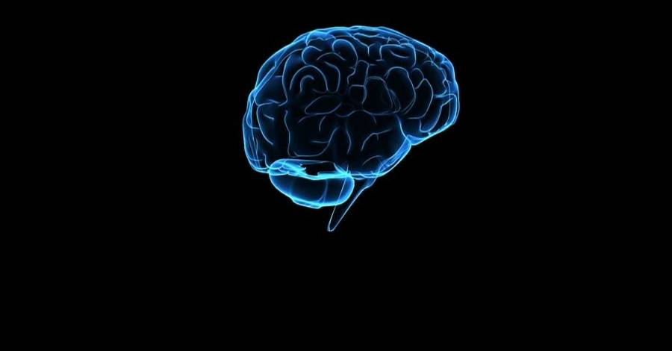
Brain Biology of Sexual Addiction
3
5
4
Frontal Brain
2
1
Limbic System
Visual Stimulus
Sexual Arousal
Dopamin elevation – positive feelings
Adaptation – Craving for more and stronger stimuli
Inability of control
2
Genital Stimulation

Slide 39
Dopamin-anchor of addiction
Quelle: S. Grüsser, Charité Berlin, www.isfb.org

Slide 40
Dopamin-anchor in non-substance dependency
Quelle: S. Grüsser, Charité Berlin, www.isfb.org

Slide 41
Dopamin anchor in cocaine dependency
Visual stimulus depicting hay balls in front of a swiss farm >>>>> elicits in cocain addicts the craving for «snow»
(Study at the University of Geneva 2009)

Slide 42
How to change the pattern
Ways to Coping

Slide 43
Addiction requires Detoxification
The biological component of sexual addiction is not to be underestimated. It can be compared to substance abuse.
„A Sex-Addict is like an alcoholic, but it is his own the brain which is his bar.“
This makes decisive withdrawal necessary.
In contrast to substance abuse, here a return to „controlled sex“ would be the ideal.

Slide 44
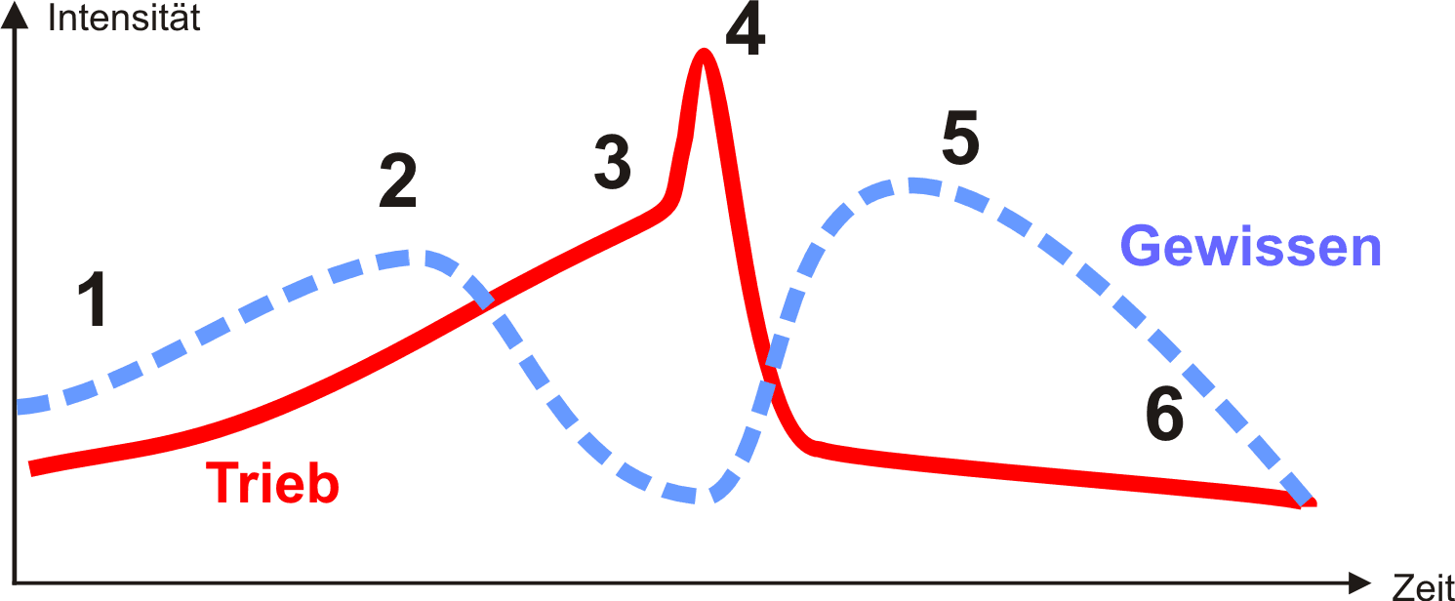
Psychodynamics: Drive and conscience
Intensity
Conscience
Drive
Time

Slide 45
Risk factors for compulsive sexuality
Lessons from Addiction Research:
Personality: impulse control, self esteem, introversion, patterns of tension reduction,
Disposition for addictive behavior upon stimuli (Award-Dependence).
Inner emptiness, isolation, emotional burnout, neglect of rewarding interpersonal relationships.
Presence of harmful material (just a click away in the Internet)

Slide 46
Risk factors
H = Hungry
A = Angry
L = Lonely
T = Tired
HALT
Define individual patterns of risk factors to modify the pattern of dependency

Slide 47
Risk factors II
Dealing with hidden emotional pain.
History of childhood trauma / neglect
Pathological search for new Stimulation.
Lack of inner discipline / behavioral control
Rationalising negative behavior: „This helps me to relax“ – „ I owe myself a treat“ – „It‘s only pictures“ etc.
Unrealistic expectations towards others, sexual partners, emotional immaturity.

Slide 49
What about medication?
Serotonin: produced as a side effect of addiction process. Antidepressants are also elevating serotonin levels.
Could Serotonin reduce Craving? – possibly reduce feelings of emptiness and underlying depression.
Dopamin (increases desire in addiction)
No proven strategies in this area without severe side effects (neuroleptics).
Opiates: central in addiction, creating the feeling of being „high“.
Although there are opioid blockers there is no indication that they reduce non-substance addiction.
Conclusion:
Medication (unfortunately) is not a solution; perhaps partially a support for behavior therapy, where a person is additionally suffering from depression.
ineffective

Slide 50
Cybersex can be destructive
Internet-Sex-Addiction is a common problem which is being increasingly recognized in psychotherapy and counseling.
Pathological Cybersex destroys the life of a person
Internally (distorted phantaies, continuous craving)
in relationships (Partner, Family)
in the workplace (Risk of job loss and poverty)
Pathologic Cybersex requires consequent application of strategies known from addiction therapy.

Slide 51
Learning from Addiction Therapy
The diverse evaluation of sexual behavior in our society makes life hard for the addicted person.
Cybersex Dependency requires consequent strategies of addiction therapy.
Detoxification: complete withdrawal.
Removal of access to addiction.
Working at immature expectations and solution strategies.
Personal discipline and responsibility.

Slide 52
Eight Tipps for addicts
Admit the fact that you are addicted.
Realize the fact that you support sexual abuse with your behavior.
Use filter software (www.max.com).
Be transparent towards your partner / counselor.
Be accountable to a person you trust.
Keep your computer in an open room.
Choose to live without a computer or internet access for some time.
Self Help Groups.

Slide 53
Goal of therapy: relationship orientation
Not secular vs. Christian
BUT: individually centered vs. stabilizing relationships.
Short term satisfaction vs. long-term integrity.
Individual lust vs. an ecology of relations.
Double moral standards vs. dignity, respect and empathy.
Lack of boundaries is destructive – conscious renouncement increases the ability to enjoy.

Slide 54
Lust in context
Counseling which emphasizes the stabilization of a relation is not opposed to lust – however it fosters a systemic view which integrates feelings of lust into a balanced (wholistic) concept of relationship.

Slide 55
Ressourcen
Interesting texts, ressources, links can be found on this homepage:
www.sexhelp.com
Download this presentation from: www.seminare-ps.net/en

