Slide 1
Religious Patients and Secular Therapists – an Ethical Challenge
Prof. Dr. med. Samuel Pfeifer, Riehen
Evangelische Hochschule Tabor, Marburg

Slide 2
Characteristics of religious persons
Structured descriptions – «centrality concept (Huber 2003) – some aspects:
My faith provides answers to many questions regarding the meaning of life
My religious convictions are what is really the foundation of my life
I am reading books about my faith or my church
It is important for me to take time for personal thoughts on my faith and for devotions
I am trying to apply my faith to all areas of my life
The presence of a divine being has been a strong personal experience at times.
FURTHER ASPECTS
Submitting to rules about clothing, food and religious holidays
Regular exercise of prescribed prayers
Participation in religious holidays
Rejection of activities, which are seen as hindering religious life
Questions of sexuality, dating and choosing a partner

Slide 3
Secular psychotherapy?
Different socialization – scientific world view
Different focus in life – western individualism
Antireligious tendencies (Sigmund Freud and others) as a historical concept of psychoanalysis
Prejudice against religious people caused by negative encounters, reports of destructive, restrictive religiosity
STUDIES:
Bergin & Jensen (1990); Delaney et al. (2007)
Religiosity of Clients is higher than rel. of therapists

Slide 4
Topics in highly religious patients
Religious dominance of everyday life
Importance of religious leaders (Priest, Rabbi, Pastor, Imam) and theological guidelines for opinion and personal behavior.
Demarcation from differing world views: We and the others.
Sexuality and choosing a marital partner (e.g. orthodox Jewish culture, Indian caste system).
Intensity of religious experience (e.g. charismatics, mysticism) and overlapping with psychiatric conditions.
Rejection of psychology, psychotherapy, and psychiatry.
Expectation of healings and miracles
Systemic aspects of family structure and family honor.

Slide 5
Special Questions
The problem of suffering
Why does God allow pain? (negative events, trauma, impairment)
Pathways to care
Hoping for a miracle through spiritual interventions, a special blessing, religious pilgrimage. ----- pathways to care (comparable to concepts of traditional folk medicine)
Spiritual Struggle
The interpretation of mental conflicts as “spiritual struggle / Satanic temptation” (cf. Exline & Pargament)
Importance of prayer
Dialogue with God / Religious duty
Ethical / moral guide-lines / taboos:
“Mortal sins”, prohibition of other world views or conversion (e.g. to Christianity, in Islam); Mating rules; threats of condemnation in case of trespass.

Slide 6
Respectful Regard
It would be presumptuous to regard highly religious patients as the measure of bliss or calamity of religious life style in general.
Even if religion may seem to be strange or constrictive for the external observer, this does not exclude high satisfaction of life.
«Only what we regard
in a respectful way,
is opening to us.»

Slide 7
Objections against psychotherapy
The secular therapist …
Could look into my emotional life too deeply.
Could change my personality
May reject my spiritual values / despise me
May change my values in a way that I would transgress my religious ideals
May not approve of my religious fellowship
May use (esoteric) therapeutic techniques, which are incompatible with my faith
STUDIES:
Belaire et al. (2002 and 2005)
Rose E, Westefeld J, Ansley T (2001)
Mohr D et al. (2006)

Slide 8
Muslim fears against therapy
„The doctors do not know my religion and will not understand me.“
„The doctors will give me advice which I cannot follow as a Muslim. “
„Therapy will lure me away from my religion.“
„I am afraid that the doctors will not respect my religion.“
„Always it’s my religion, which is blamed for my problems!“
(compiled by Laabdallaoui und Rüschoff 2010, p. 31)

Slide 9
Cults / Religious sub-groups
„We were not allowed to get help from outside our fellowship, as perfect divine help has to be demonstrated for outsiders. Where God is leading directly, there can be no contradiction and no disharmony. And if so, the Devil is involved. If you have problems, you are lacking faith! “

Slide 10
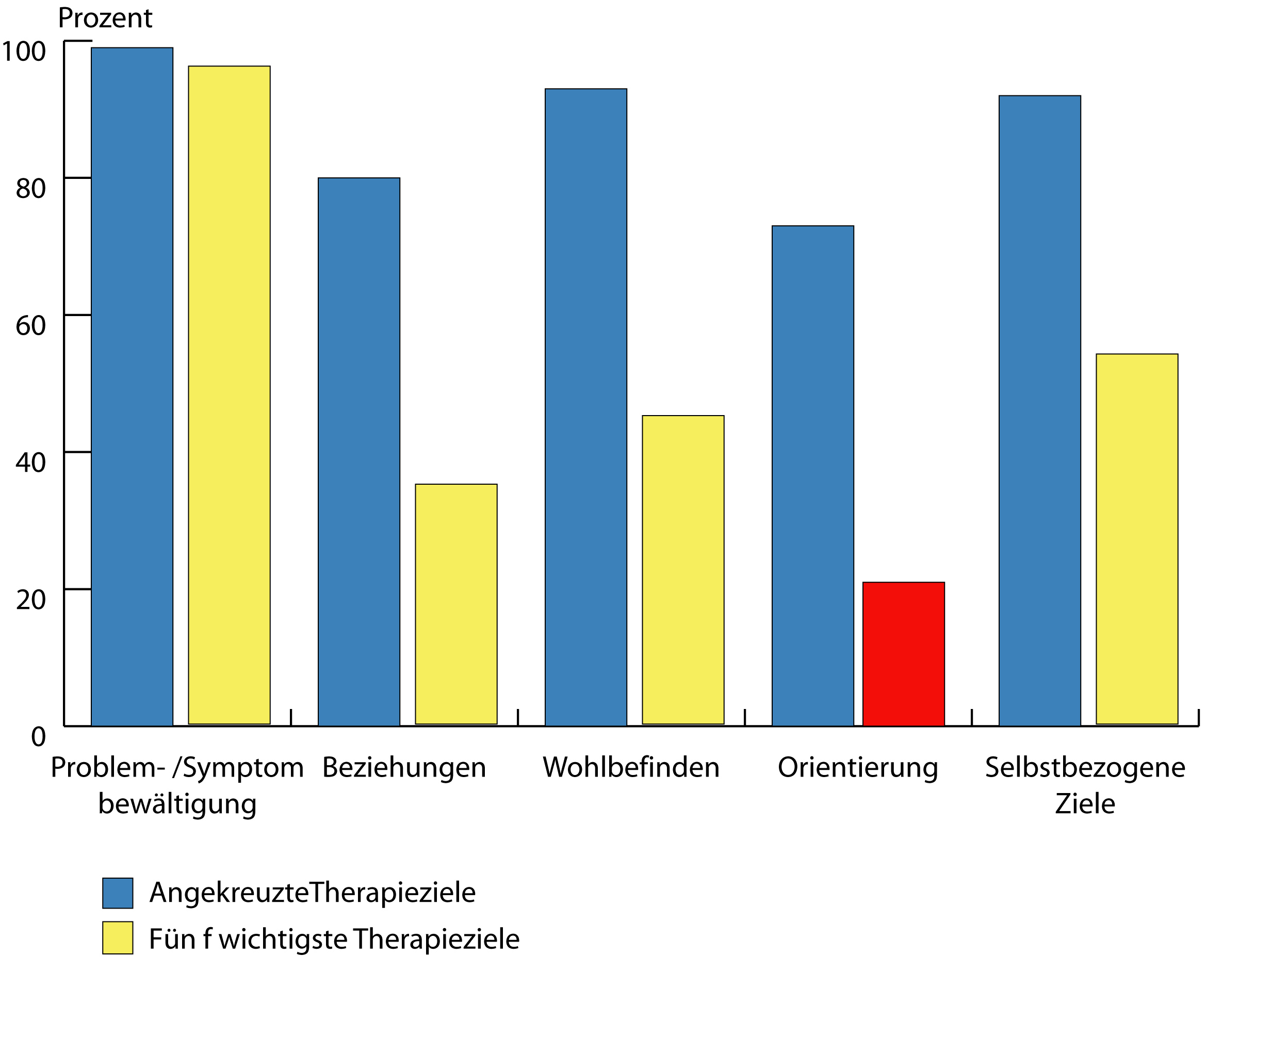
Goals in psychotherapy
only 3 % are looking for the meaning of life in therapy
M. Grosse Holtforth & Grawe 2001

Slide 11
How can we approach the topic – in a culturally sensitive way – in ethical responsibility – with a focus on therapeutic goals?

Slide 12
Expectations in Therapy
With the help of Psychotherapy I would like ...
To better cope with my problems in family life / at the workplace
Reduce my emotional swings
Reduce my troubled thoughts, my ruminations, my worries
Learning strategies against my fears
Become happier and more active
To work through my divorce
Better cope with stress
Overcome my “exam nerves”
More examples …
General improvement of personal functioning
Notes:
Erwartungen an eine Psychotherapie
"Mit Hilfe der psychotherapeutischen Behandlung möchte ich.....
Meine Probleme ("persönliche Baustellen") in der Familie oder am Arbeitsplatz besser bewältigen lernen
Meine Stimmungsschwankungen reduzieren
Meine kreisenden Gedanken, ständiges Grübeln, Sich-Sorgen reduzieren
Methoden kennen lernen, die mir helfen, weniger Angst zu haben
Nicht mehr so traurig und antriebsarm sein
Die Scheidung besser verarbeiten
Mit Stresssituationen besser umgehen lernen
Meine lähmende Prüfungsangst überwinden
Lernen, Dinge zu tun, die ich seit Jahren aus Angst vermeide (z.B. Autofahren)
Meine Kräfte besser einteilen und meine Grenzen erkennen und akzeptieren
Nein-Sagen lernen und besser eigene Bedürfnisse / Wünsche äußern
Perfektionistische Ansprüche an mich reduzieren
Angst- und Panikattacken überwinden
Selbstsicherer werden, Schüchternheit überwinden
Nicht mehr so stark von der Meinung anderer abhängig sein
Mich trauen, meine Meinung zu sagen und mich besser durchzusetzen
Mich mit meinem Partner wieder besser verstehen
Die Ursachen meiner emotionalen Probleme herausfinden und mich dadurch besser verstehen
Mit heftigen Gefühlsausbrüchen umgehen lernen
Mit körperlichen Schmerzen umgehen lernen
Die tiefe Trauer nach dem Tod meines Partners verarbeiten/überwinden
Meine psychosomatischen Beschwerden besser bewältigen
Mich um soziale Kontakte, meine Interessen und positive Freizeitaktivitäten kümmern
Mich um mehr Lebensqualität kümmern
Eine bessere Tagesstruktur aufbauen
Mich nicht mehr über jede Kleinigkeit ärgern und so viel Streit mit meiner Tochter haben
Mehr Durchhaltevermögen und Selbstdisziplin entwickeln
Von meinen wiederholten, sinnlosen und zeitraubenden Gedanken und Handlungen loskommen (z.B. Händewaschen, Ordnen etc.)
Wieder besser schlafen können (Ein- und Durchschlafen)
Mich tagsüber ausgeruht und leistungsstark fühlen
Mein Suchtmittelkonsum (Alkohol) unter Kontrolle bringen
Besser mit anderen Leuten reden lernen und Kontakte knüpfen
Ein schlimmes, traumatischer Erlebnis überwinden
Nach meiner Trennung vor 4 Monaten neue Ziele und Wege im Leben finden
Gefunden bei http://www.psychotherapie-paterok.de/therapieziele.html

Slide 13
Religious Struggles / Conflicts
Research by J. Exline and K.I Pargament 2013 / Pfeifer 2009
Religious doubt
Instability in perceived relationship with God
Anger/disappointment toward God
Religious fear and guilt
Life satisfaction
Demonic causal attributions
Interpersonal disappointment (with fellow believers)
Moral conflicts
Explaining life and negative events
Exline JL, Pargament KI, Grubbs JB & Yali AM (2014).
Notes:
Exline JL, Pargament KI, Grubbs JB & Yali AM (2014). The religious and spiritual struggles scale. Development and initial validation. Psychology of Religion and Spirituality 6:208-222.

Slide 14
Paradox in Psychotherapy
On the one hand desire for problem resolution
On the other hand retaining maladaptive patterns (in Psychodynamics, relations or spiritual issues)
«A constant battle between the analyst and the resistance of the client.» (Menninger)
Danger: Focus on resistance instead on resources.
Notes:
Menninger (1961, zitiert bei Narramore B (1994) Dealing with religious resistance in psychotherapy. Journal of Psychology and Theology 22(4):249-258

Slide 15
Guidelines
Empathy before Exploration
Only if patients feel that we are truly interested in their struggles, will they open up in psychotherapy
Spirituality in context
The primary goal of psychotherapy is not spiritual guidance but the alleviation of suffering, strengthening the person, giving perspective and hope.
Spirituality is only explored insofar as it helps to improve general coping.
Notes:
Griffith J (2013). Religion hilft, Religion schadet: Wie der Glaube unsere Gesundheit beeinflusst. Wissenschaftliche Buchgesellschaft, Darmstadt.

Slide 16
The locus of spirituality in the bio-psycho-social model
SPIRITUALITY
PSYCHO
BIO
SOCIAL
BIO-PSYCHO-SOCIAL MATRIX

Slide 17
Approaching spirituality
Listening to «spiritual cues»
Existential Exploration (Griffiths)
Danger of «spiritual counter-transference»:
Heightened emphasis on spiritual issues because of your personal interest.
Losing sight of central therapeutic goals.

Slide 18
Religion as environmental conditioning/ as theme in therapy
CONDITIONING
THEMES
Subcultural Socialization*
Psychodynamics / Role Behavior
PERSON
Pathogenesis / «Spiritual Struggle»
Faith as Coping
Conflict Management / Psychopathology
Traumatization
(Spiritual Abuse)
What is helpful – destructive ?
* In the context of the prevalent culture

Slide 19
The highly religious patient in therapy is…
A suffering person (often with religious „idioms of distress“).
A person with subcultural values / history.
A person in conflict (within him/herself, with his/her religious values and with his / her environment /peers).
A person who experiences weakness, in which the promises and the coping strategies of religion do not really help.
A person with the desire for love and happiness (perhaps in contrast to religious rules and laws).
A person with his / her «shadow», i.e. destructive tendencies, impulses and desires, which are not compatible with religious ethics.

Slide 20
Ethical Attitude
Respect
Responsibility
Integrity
Competence
Concern
NOTICE:
Tension between religious duties and damage to health and existence
Role Conflicts
Plante TG (2007) Integrating spirituality and psychotherapy: ethical issues and principles to consider. Journal of Clinical Psychology 63:891-902.
Notes:
Die ethischen Spannungsfelder wurden von Plante (2007) unter dem Akronym „RRICC“ beschrieben: Respect, Responsibility (Verantwortung), Integrity, Competence und Concern. Der Therapeut ist in erster Linie dem Wohlbefinden des Patienten verpflichtet. Es gilt sorgfältig abzuwägen zwischen Einhaltung von religiösen Pflichten und Schaden für Gesundheit und Seele. Integrität bedeutet aber auch, sich nicht in Rollenkonflikte verwickeln zu lassen. So kann es sein, dass eine Patientin von einem Priester überwiesen wird, jedoch mit dem Auftrag, sie so weit wiederherzustellen, dass sie die Anforderungen der religiösen Gemeinschaft wieder erfüllen kann. Eine sorgfältige Klärung des Auftrages, der Rollenverteilung und der Eigenständigkeit der Patientin ist ethisch unabdingbar.
Die interkulturelle Kompetenz kann durch eine Vertrautheit mit Religion (sei dies durch Begegnungen oder durch eine intensive Selbsterfahrung) stark gefördert werden. Für das orthodoxe Judentum haben Bilu & Witztum (1993) einen sehr anschaulichen Leitfaden zum Verständnis von Patienten aus diesem Hintergrund geschrieben. Die unterschiedlichen Werte von Patient und Psychotherapeut erfordern dabei ein sorgfältiges Abwägen von Begrifflichkeiten und therapeutischen Zielsetzungen (Worthington 1988). Integrität bedeutet dabei auch, dass der Therapeut dazu stehen darf, dass er zwar nicht alle Glaubenssätze teilen kann, aber versucht, sich in die Welt des Patienten einzufühlen. Bilu & Witztum (1993) nennen dies eine „temporäre Suspension des Unglaubens“ auf beiden Seiten. Wenn eine klare therapeutische Haltung verbunden wird mit einer warmherzigen Anteilnahme am persönlichen Ergehen der Person, dann kann die Therapie mit hochreligiösen Menschen nicht nur erfolgreich sein, sondern auch für den Therapeuten im besten Sinne „inspirierend“ sein.

Slide 21
Religion as a meta-therapeutic topic
Religion should only be addressed in therapy if it is brought up by the patient.
Religion is not a shared spiritual practice / ritual in the context of the therapeutic setting.
Religion as meta-therapeutic topic: «Talking about religion», but not «Practicing as a religious ritual».
Exceptions:
Mindfulness Exercises, if possible with minimal religious connotation
Prayer in individuals who explicitly do wish prayer (e.g. at the end of a session cf. Weld & Eriksen 2007)

Slide 22
Culture and the Interpretation of Rel. Phenomena
Pathological
Experiences
Shared culture
* PAT = The suffering person shows both functional and dysfunctional aspects of behavior and ideas, some of which may be religious.
PAT*
Psychiatrist
Observer
Subculture
Religion
Interpretation
Diagnosis
Cultural Sensitivity
Subculture
Professional Training, personal history
Life events

Slide 23
Intercultural Competence in Psychotherapy
Curiosity and value-free interest in the religious life of a person.
Respectful balance between useful and hindering aspects of religious convictions. (Griffiths 2013)
Open discussion of positive emotions, be it independent of religious premises (“I am free to do so!”) or in a different view of a loving God, who wants my personal happiness.
Refrain from touching religious laws, if they are viewed as fundamental and indisputable.

Slide 24
Integrity
The therapist may indicate that he / she cannot share religious presumptions, but that she / he tries to understand why religion is important to the patient.
«Temporary suspension of unbelief» on both sides(Bilu & Witztum 1993)
Clear therapeutic attitude, combined with warm interest in the personal experience of the client.

Slide 25
The End
DOWNLOAD:
www.samuelpfeifer.com

Slide 26
Abstract
There is a substantial degree of anxiety regarding psychotherapy. Individual fears and subcultural reservations play a major role. In religious patients, the question of the acceptance of their values is essential. Research has shown that psychotherapy can never be completely unbiased. Although therapists try to have empathy with their clients, they will not be able to conceal their personal background of values completely. This creates a highly loaded network of countertransference and value considerations. Therapy thus becomes an art to develop a common ground of change and to evaluate in which way religious assumptions can serve as helpful or as dysfunctional factors which have to be modified. Clinical examples illustrate the ethical tensions and serve to develop basic guidelines in dealing with religious patients.

Slide 27
Further Literature
If you are interested in further literature, please address your request to my E-Mail:
samuelpfeifer@gmail.com

