Slide 1
Personality Disorders and Sensitivity:
An Overview
Dr. Samuel Pfeifer

Slide 2
What is a healthy personality?
There are many possible answers / models
Excellent overview:
  Vaillant G.: Mental Health,
  American Journal of Psychiatry 2003; 160:1373–1384
Three Models:
  Mental Health Normality
  Positive Psychology
  Maturity
Notes:
George E. Vaillant (2003): Mental Health. American Journal of Psychiatry 160:1373–1384.

Slide 3
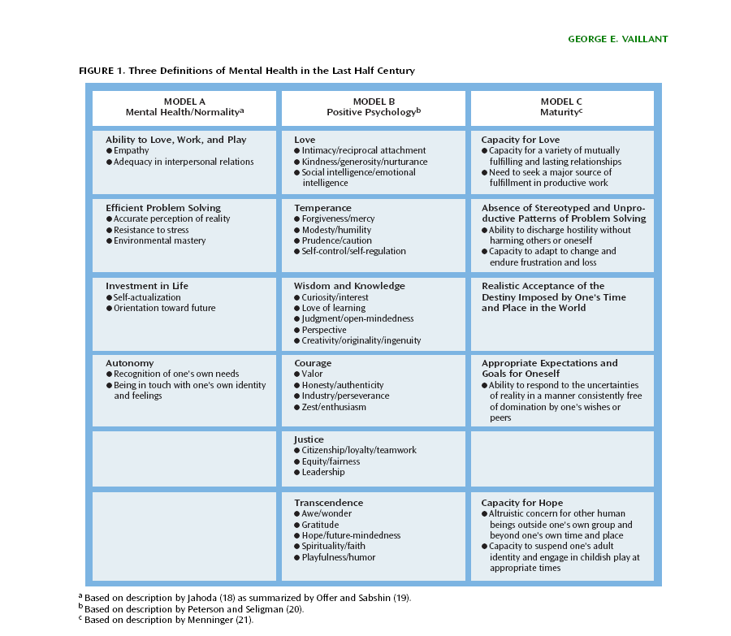

Slide 4
What purpose does personality serve?
for myself or for society?
adaptation or creativity?
my wellbeing or survival?

Slide 5
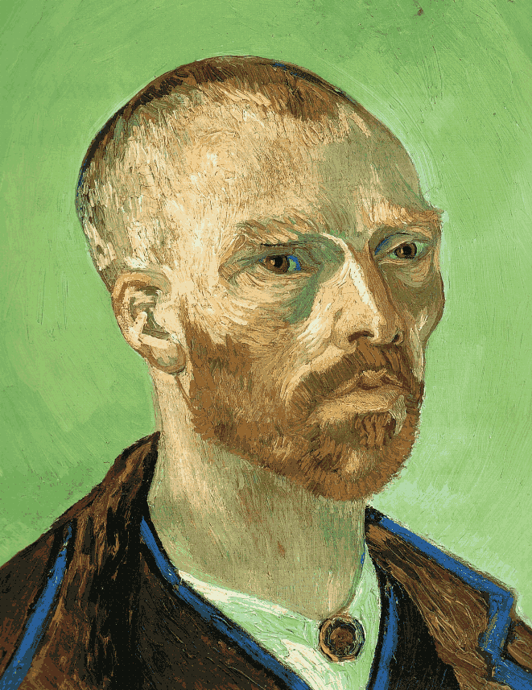
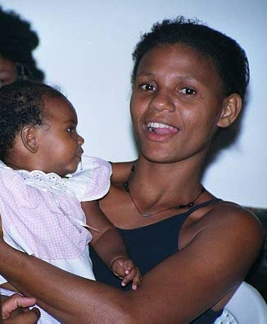
Creativity or Survival?
Notes:
Van Gogh ––- Street Girl Brasil

Slide 6

What is a healthy personality?

Slide 7
What is a healthy personality?
SHORT FORMULA:
ability to enjoy, to relate and to work.
„Psychologically healthy with a positive development is a person who is able to utilize eight aspects or polarities – depending on life context or requirement – in a way that is situational or functional. “ (Fiedler)
Notes:
Als psychisch gesund mit positiver Persönlichkeitsentwicklung wäre eine Person zu bezeichnen, die sich – je nach Lebenskontext und Lebensanforderung – aller acht Bedürfnisaspekte bzw. Polaritäten situationsspezifisch und funktional bedienen wird. (131)
Zwei Zielkonstrukte:
a) sozialbezogene Autonomie
b) erfahrungsoffene Selbstsicherheit
Therapeutische Vorschläge (Millon 1996):
1. Bringe die extremen Pole ins Gleichgewicht
2. Wirke den wiederholten dysfunktionalen Mustern entgegen
3. Ergreife praktische Schritte (Tactical Modalities)
Das Gute, das ich tun will, tue ich nicht
Take-Home-Messages
1. in uns allen schlummern Regungen und unerfüllte Wünsche, die uns oft nicht so reagieren lassen, wie wir möchten (Römer 7)
2. Nicht nur auf die Schwächen schauen – auch die Stärken sehen.
3. Anreichern der Persönlichkeit mit anderen Anteilen – welche Anteile möchte ich bei mir verstärken?
4. Wir leben nicht allein – persönliche Nische (Willi) – Spannungsfeld Person – Ideal – Umgebung – Realität.
5. Lernen Spannungen auszuhalten und eine persönliche Mitte finden. – hier vielleicht geistliche Ansätze.

Slide 8
Eight Modalities of Personal Functioning
Individuality, Independence.
Relationship, Attachment, Security.
Spontaneity, Desire for New Experiences, Instability.
Stability, Self control, Security.
Wellbeing, Pleasure.
Allowing and accepting pain, Melancholy
Actively structuring life − Manipulation.
Passive Receiving, letting things happen.
(according to Fiedler/Millon)

Slide 9
Common themes in normality
strength of character
ability to learn from experience
ability to work
ability to achieve insight
absence of symptoms/conflict
ability to experience pleasure without conflict
flexibility/ability to adjust
ability to laugh
ability to love another
degree of acculturation

Slide 10
Where is the line?
It’s all a matter of degree and which traits:
e.g. To be a successful pilot, a person must have a degree of narcissism (healthy sense of self-confidence) and obsessive compulsive (attention to detail, conscientious).

Slide 11
See the whole person
Therefore, don’t rely on a single, “slice-in-time” conclusion when considering traits
The most normal person can
look pretty disordered at times when stressed

Slide 12
Characteristics of Personality Disorders
An enduring pattern of inner experience and behavior that deviates markedly from the expectations of the individual’s culture,
is pervasive and inflexible,
has an onset in adolescence or early adulthood,
is stable over time,
and leads to distress or impairment.

Slide 13
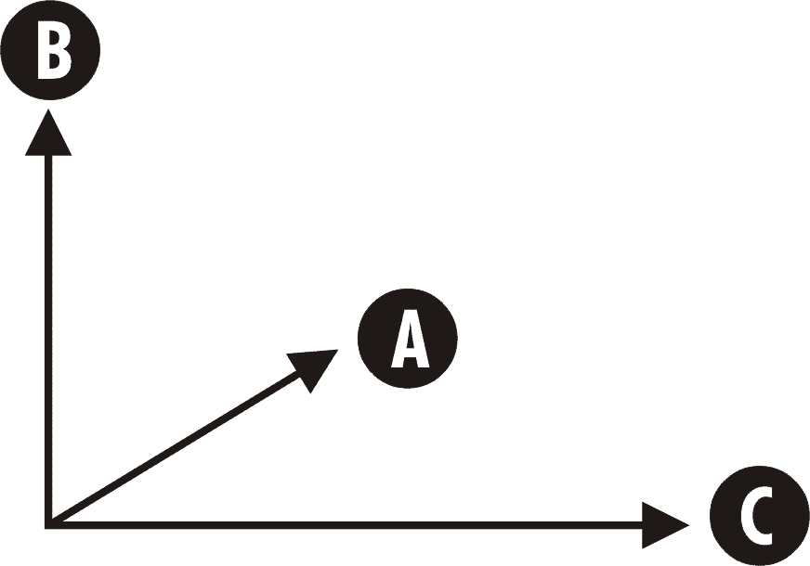
Dimensions
DSM-IV:
Cluster A – Odd or eccentric cluster (e.g., paranoid, schizoid)
Cluster B – Dramatic, emotional, erratic cluster (e.g., antisocial, borderline)
Cluster C – Fearful or anxious cluster (e.g., avoidant, obsessive-compulsive)
Emotional
Dramatic
Odd
Excentric
Anxious
Fearful
Avoidant

Slide 14
Personality Disorders: Facts and Statistics
Prevalence of Personality Disorders
  Affect about 0.5% to 2.5% of the general population
  Rates are higher in inpatient and outpatient settings
Origins and Course of Personality Disorders
  Thought to begin in childhood
  Tend to run a chronic course if untreated
Co-Morbidity Rates are High (depression, anxiety)

Slide 15
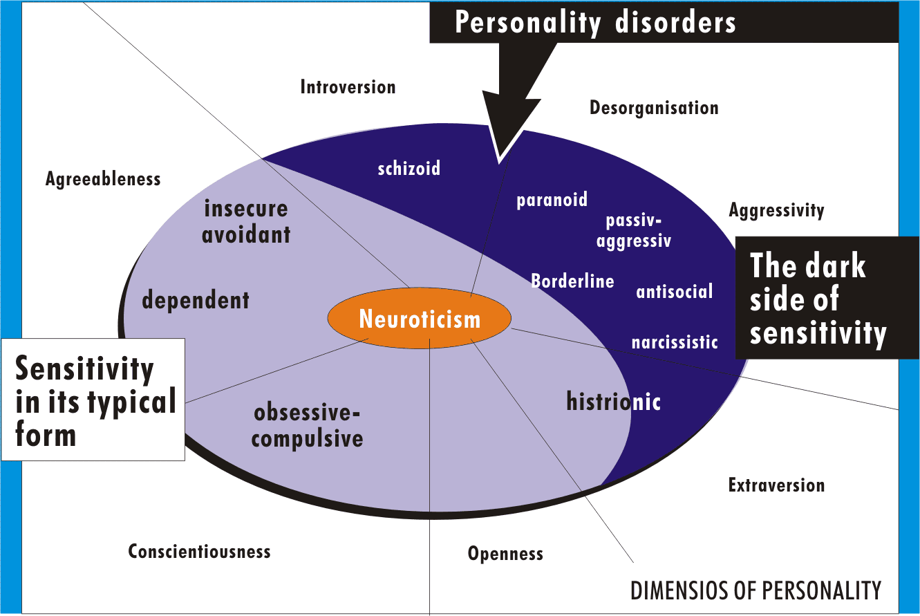
Types of Personality Disorders

Slide 16
Cluster A: Paranoid Personality Disorder
Overview and Clinical Features
  Pervasive and unjustified mistrust and suspicion
The Causes
  Biological and psychological contributions are unclear
  May result from early learning that people and the world is a dangerous place
Treatment Options
  Few seek professional help on their own
  Treatment focuses on development of trust
  Cognitive therapy to counter negativistic thinking
  Lack good outcome studies showing that treatment is efficacious

Slide 17
Cluster A: Schizoid Personality Disorder
Overview and Clinical Features
  Pervasive pattern of detachment from social relationships
  Very limited range of emotions in interpersonal situations
The Causes
  Etiology is unclear
  Preference for social isolation in schizoid personality resembles autism
Treatment Options
  Few seek professional help on their own
  Focus on the value of interpersonal relationships, empathy, and social skills
  Treatment prognosis is generally poor
  Lack good outcome studies showing that treatment is efficacious

Slide 18
Cluster A: Schizotypal Personality Disorder
Overview and Clinical Features
  Behavior and dress is odd and unusual
  Most are socially isolated and may be highly suspicious of others
  Magical thinking, ideas of reference, and illusions are common
  Risk for developing schizophrenia is high in this group
The Causes
  Schizoid personality – A phenotype of a schizophrenia genotype?
  Left hemisphere and more generalized brain deficits
Treatment Options
  Main focus is on developing social skills
  Treatment also addresses comorbid depression
  Medical treatment is similar to that used for schizophrenia
  Treatment prognosis is generally poor

Slide 19
Cluster B: Antisocial Personality Disorder
Overview and Clinical Features
  Failure to comply with social norms and violation of the rights of others
  Irresponsible, impulsive, and deceitful
  Lack a conscience, empathy, and remorse
Relation Between Psychopathy and Antisocial Personality Disorder
Relation Between ASPD, Conduct Disorder, and Early Behavior Problems
  Many have early histories of behavioral problems, including conduct disorder
  Many come from families with inconsistent parental discipline and support
  Families often have histories of criminal and violent behavior

Slide 20
Cluster B: Borderline Personality Disorder
Overview and Clinical Features
  Patterns of unstable moods and relationships
  Impulsivity, fear of abandonment, coupled with a very poor self-image
  Self-mutilation and suicidal gestures are common
  Most common personality disorder in psychiatric settings
  Comorbidity rates are high
The Causes
  Borderline personality disorder runs in families
  Early trauma and abuse seem to play some etiologic role
Treatment Options
  Few good treatment outcome studies
  Antidepressant medications provide some short-term relief
  Dialectical behavior therapy is the most promising psychosocial approach

Slide 21
Cluster B: Histrionic Personality Disorder
Overview and Clinical Features
  Patterns of behavior that are overly dramatic, sensational, and sexually provocative
  Often impulsive and need to be the center of attention
  Thinking and emotions are perceived as shallow
  Common diagnosis in females
The Causes
  Etiology is largely unknown
  Is histrionic personality a sex-typed variant of antisocial personality?
Treatment Options
  Few good treatment outcome studies
  Treatment focuses on attention seeking and long-term negative consequences
  Targets may also include problematic interpersonal behaviors
  Little evidence that treatment is effective

Slide 22
Cluster B: Narcissistic Personality Disorder
Overview and Clinical Features
  Exaggerated and unreasonable sense of self-importance
  Preoccupation with receiving attention
  Lack sensitivity and compassion for other people
  Highly sensitive to criticism
  Tend to be envious and arrogant
The Causes
  Link with early failure to learn empathy as a child
  Sociological view – Narcissism as a product of the “me” generation
Treatment Options
  Extremely limited treatment research
  Treatment focuses on grandiosity, lack of empathy, unrealistic thinking
  Treatment may also address co-occurring depression
  Little evidence that treatment is effective

Slide 23
Cluster C: Avoidant Personality Disorder
Overview and Clinical Features
  Extreme sensitivity to the opinions of others
  Highly avoidant of most interpersonal relationships
  Are interpersonally anxious and fearful of rejection
The Causes
  Numerous factors have been proposed
  Early development – A difficult temperament produces early rejection
Treatment Options
  Several well-controlled treatment outcome studies exist
  Treatment is similar to that used for social phobia
  Treatment targets include social skills and anxiety

Slide 24
Cluster C: Dependent Personality Disorder
Overview and Clinical Features
  Excessive reliance on others to make major and minor life decisions
  Unreasonable fear of abandonment
  Tendency to be clingy and submissive in interpersonal relationships
The Causes
  Still largely unclear
  Linked to early disruptions in learning independence
Treatment Options
  Research on treatment efficacy is lacking
  Therapy typically progresses gradually
  Treatment targets include skills that foster independence

Slide 25
Cluster C: Obsessive-Compulsive Personality D.
Overview and Clinical Features
  Excessive and rigid fixation on doing things the right way
  Tend to be highly perfectionistic, orderly, and emotionally shallow
  Obsessions and compulsions, as in OCD, are rare
The Causes
  Are largely unknown
Treatment Options
  Data supporting treatment are limited
  Treatment may address fears related to the need for orderliness
  Other targets include rumination, procrastination, and feelings of inadequacy

Slide 26
Therapies for Personality Disorders
Disorder
Style
Ultimate goal is to turn disorder into style
Often treated in context of comorbid Axis I diagnosis
Psychotropic medication may be prescribed based on Axis I features it resembles
Psychodynamic therapy looks at childhood problems underlying personality disorder
Behavioral and cognitive approaches look at individual problems that reflect personality disorder

Slide 27
The inner struggle
„I find then a law, that, when I would do good, evil is present with me.
For I delight in the law of God after the inward man:
But I see another law in my members warring against the law of my mind, and bringing me into captivity to the law of sin which is in my members,
(The apostle Paul – Romans 7,21–23)

Slide 28
„the other law“
attitudes, actions and words which can hurt others.
Drives, feelings, and thoughts which can poison our inner world
Anxiety (Neuroticism)
Lack of energy (gr. oligopsychos, astheneia)
„SIN“
WEAKNESS
(1. Thess. 5,14; 2. Kor. 12,9)
Notes:
Sünde:
in uns brechen Regungen auf, die andere verletzen:
Wut, gekränkter Rückzug, Ichbezogenheit, Impulsivität etc. und die vielen Dinge, die eine Übertretung von Regeln, Geboten und Grenzen beinhalten, von der Geschwindigkeitsübertretung bis zum Konsum von Kinderpornographie.
Regungen, die uns innerlich vergiften: Eifersucht, Neid, das Gefühl, ewig zu kurz zu kommen etc.

Slide 29
Areas of tension
I D E A L S
Inner
Experience
I want to do what is right and good, pleasing to God.
*** other ideals ??
Needs, desires
Drives, Impulses
Emotions
(Sub)cultural
rules und
limitations
R E A L I T Y
General life situation
Social network
Physical/emotional constitution
External
Framework

Slide 30
Conflicts: Which values are important to us?
Relationship
High view
of relationship
Giving way
Solving
Personal
needs not
met
Compromise
Personal
needs
met
Retreating
Winning
Low view
of relationship
Needs
Practical questions

Slide 31
Questions to ponder
Where should I listen more to my heart?
Where should I overcome my fears?
Where do I need to have an open word or take a courageous decision?
Where do I have to take back myself and my expectations of others?
What can I add to a positive climate in a relationship or in a team?

Slide 32
Download this presentation from
www.seminare-ps.net
Notes:
Man könnte also sagen, die Religiosität sei eine inhaltliche Ausprägung eines grundlegenden neurotischen Prozesses, religiöser Inhalt eines pathodynamischen Gefäßes. Es wäre daher sinnvoll, den kausalen Begriff der "Ekklesiogenen Neurose" durch den Begriff "Ekklesiomorphe Neurose" zu ersetzen. Damit wird die Beziehung zwischen Religiosität von Neurose ausgedrückt, aber in einen breiteren Kontext gestellt. Der religiöse Konflikt ist nur eine Sonderform der allgemeinen neurotischen Konfliktsituation des einzelnen zwischen seinem inneren Erleben und der äußeren Welt
„Consideration should be given to how patients use their religious belief systems as a vehicle for the expression of neurotic needs and conflicts, in particular to identify patterns of symptomatic and characterological expression with their particular religious phenomenology“

